Slide 1
BHS Billing Unit
Billing Office Hours
July 23, 2026

Slide 2

Meeting Agenda
BHS BU New Contact Info
Reminder
  Review/Resolve charges staged to 9999 plan – focus on DOS that is fast approaching timely filing deadline with DHCS (12 months from DOS)
  Run CoSD Client Insurance & Time Span Report and verify date spans on coverage plans before submitting Client Insurance Plan Request
  Review/Resolve Service Errors
Reports
  CoSD Client Ledger Report
  CoSD Authorizations Report
  CalMHSA 814 – Claims Denial Contractor Report
  CalMHSA 120 –CalMHSA BH Connect Monthly Services Report – permissioned only to staff who have MOD override role
Q&A

Slide 3

BHS Billing Unit Contact Information
BHS Billing Unit - Mental Health and Substance Use Disorder new email addresses. Effective immediately, please send the:
MH billing and billing-related emails to: MHBillingUnit.BHS@sdcounty.ca.gov
ADP or SUD billing and billing-related emails to: SUDBillingUnit.BHS@sdcounty.ca.gov
The BHS Billing Unit's old email addresses will remain active and monitored until 08/31/2026.
MHBillingUnit.HHSA@sdcounty.ca.gov (MH)
ADSBillingUnit.HHSA@sdcounty.ca.gov (SUD)
Please refer to our contact details and updates in the business email signature.

Slide 4
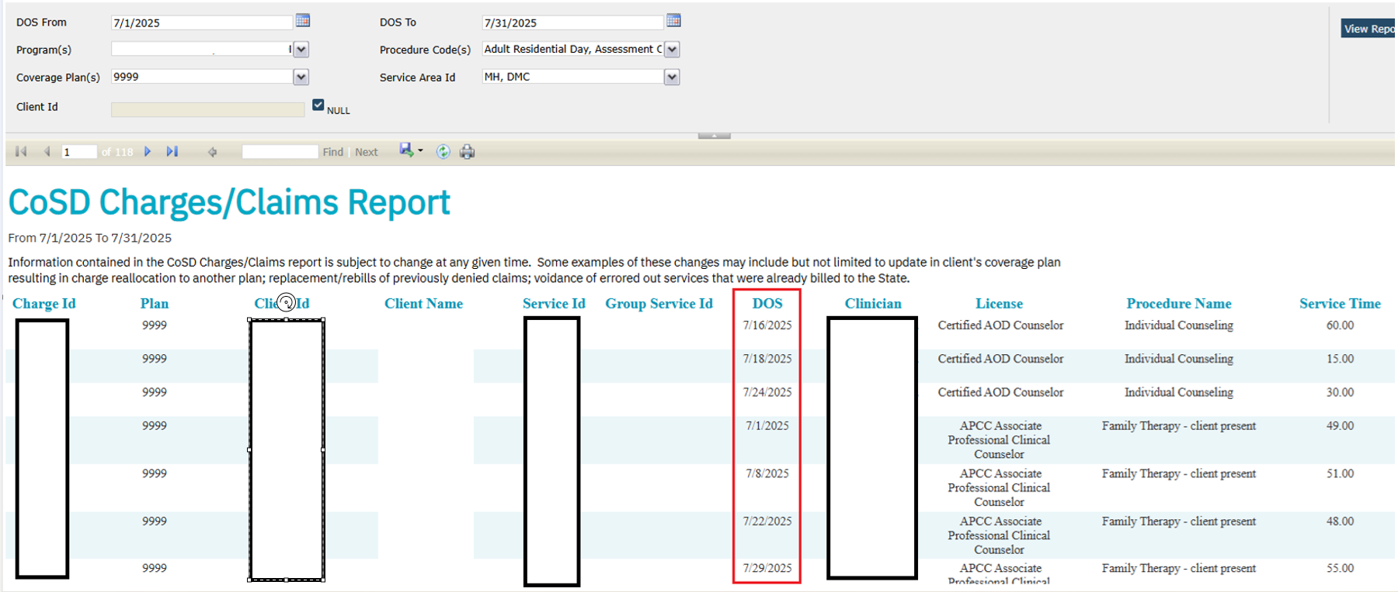
CoSD Charges/Claims Report – 9999 Coverage Plan
Notes:
For SmartCare Rx only (versus CalMHSA Rx), specifically home medications (self-reported), an issue has been identified where entering a value in the Date Initiated field can overwrite the Start Date when an End Date is not entered. This may result in inaccurate medication date information.
Until this issue is resolved, please do not populate the Date Initiated field for home (self-reported) medications. Instead, document medication dates using only the Start Date and End Date fields.
CalMHSA is actively working with Streamline on a permanent fix. An estimated timeline for the resolution will be shared as soon as it becomes available.

Slide 5
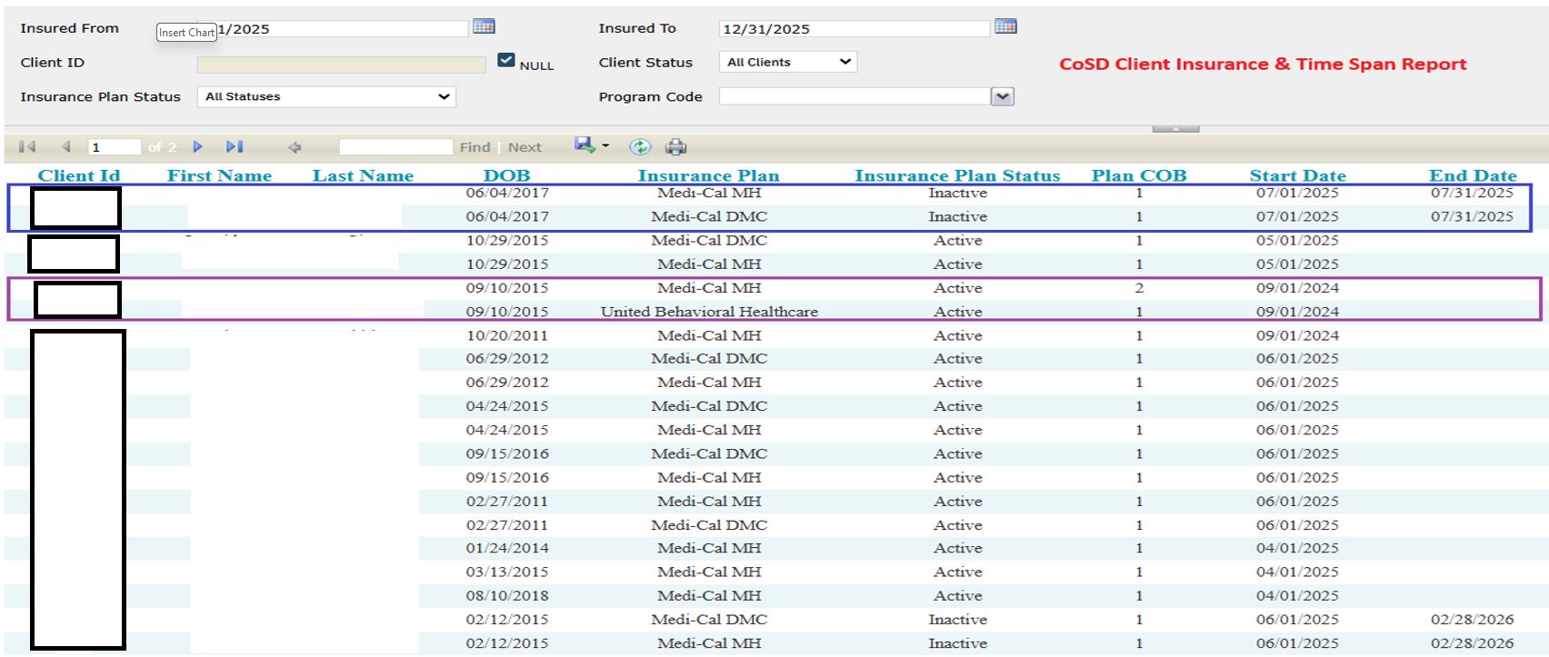
CoSD Client Insurance & Time Span Report
Notes:
For SmartCare Rx only (versus CalMHSA Rx), specifically home medications (self-reported), an issue has been identified where entering a value in the Date Initiated field can overwrite the Start Date when an End Date is not entered. This may result in inaccurate medication date information.
Until this issue is resolved, please do not populate the Date Initiated field for home (self-reported) medications. Instead, document medication dates using only the Start Date and End Date fields.
CalMHSA is actively working with Streamline on a permanent fix. An estimated timeline for the resolution will be shared as soon as it becomes available.

Slide 6
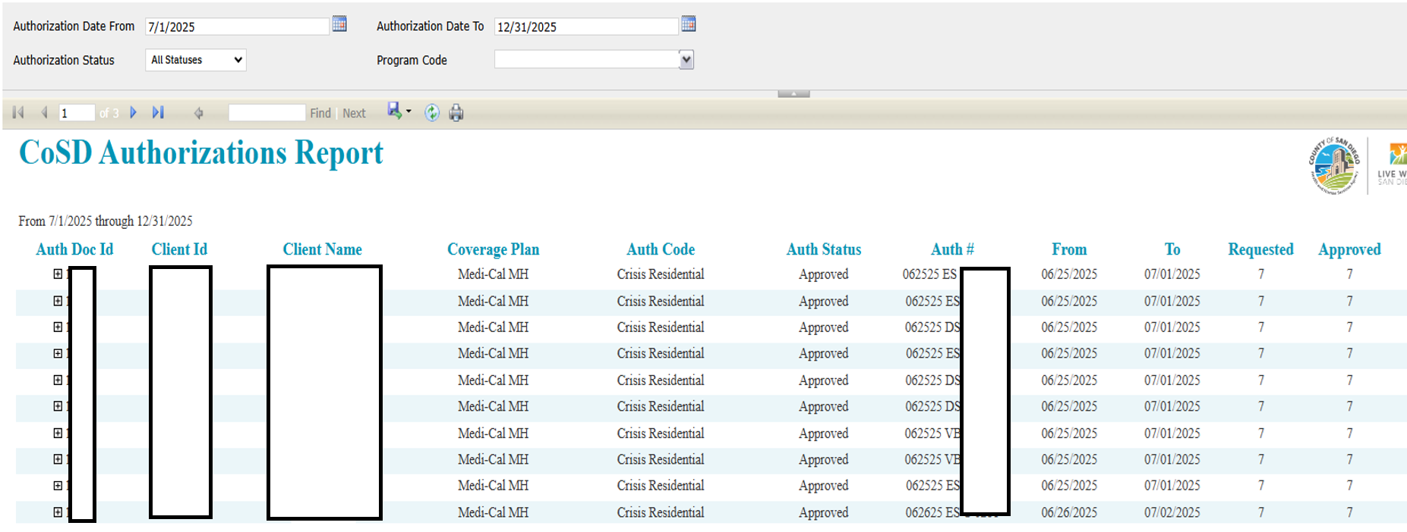
CoSD Authorizations Report
Notes:
Staff can now more easily review a client’s ASCMI consent preferences as captured within SmartCare by navigating to the Client Information Screen (Custom Fields tab) and viewing the summary of the client’s ASCMI data sharing preferences for each data type, as well as the date of signature and form expiration date.
This section will automatically update with any new ASCMI data captured within SmartCare on a per-client basis.

Slide 7
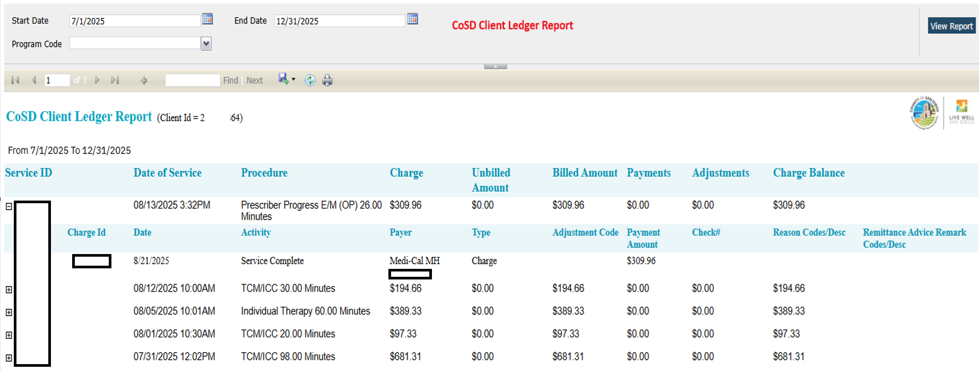
CoSD Client Ledger Report
Notes:
To support documentation consistency and prevent an unintentionally blank field, the Other General Medical Conditions field in the SmartCare Diagnosis document will now automatically populate with 'N/A' by default.
What this means for staff:
• If the person you are supporting has no other significant general medical conditions, no action is needed — N/A will remain in the field.
• If there are relevant medical conditions to document, simply delete the text and enter the appropriate clinical information.

Slide 8
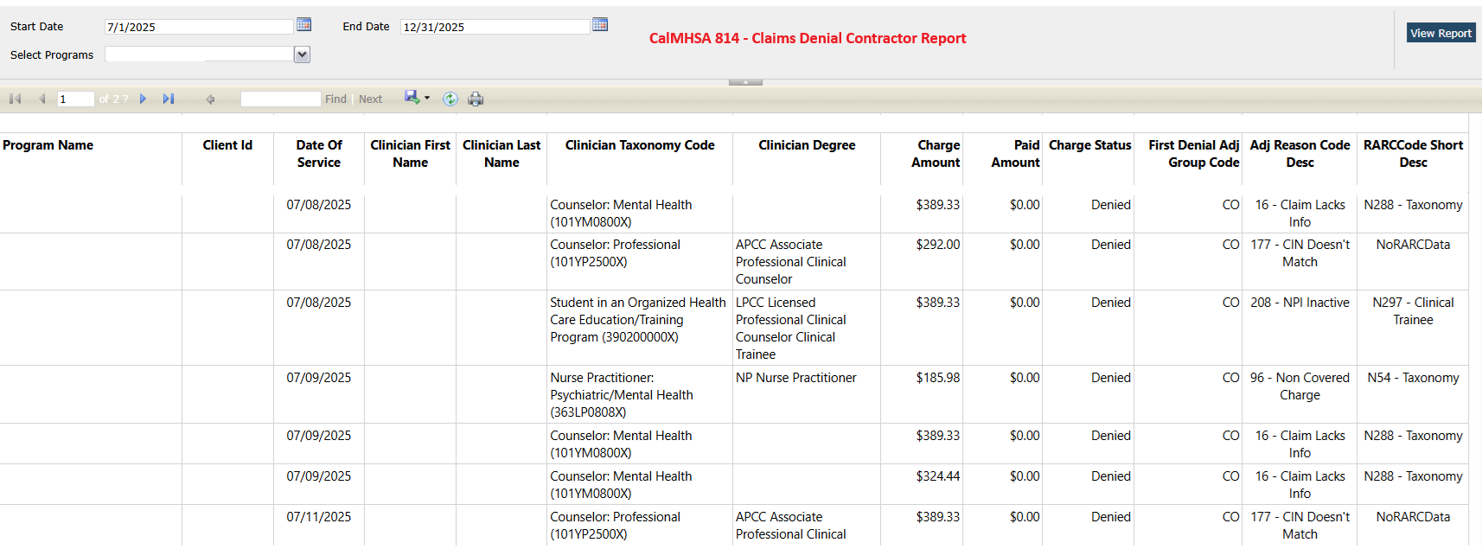
CalMHSA 814 – Claims Denial Contractor Report

Slide 9
CARC and RARC
The CARC (Claim Adjustment Reason Code) and RARC (Remittance Advice Remark Code) are standardized codes provided by insurance companies to explain why a medical claim was denied, reduced, or paid differently than billed.
CARC and RARC are included in the electronic remittance advices (ERAs) or explanations of benefits (EOBs) that the BHS Billing Unit posts to SmartCare.
The CARC and RARC tables are posted on the BHS Optum Billing resources website for your reference.

Slide 10
Medi-Cal Claim Denials
Currently, denial lists are emailed to programs until a provider version of the denial report becomes accessible for use in SmartCare.
If you receive an email denial from your program, it's recommended to review and validate the denial.
Please respond to the BHS billing team via email if you agree or disagree with the state determination.
Claims that are eligible for service replacement or rebill will be processed by the BHS Billing Unit.

Slide 11
The CARC and RARC tables are posted on the BHS Optum Billing resources website for your reference.
MH CARC and RARC
SUD CARC and RARC

Slide 12
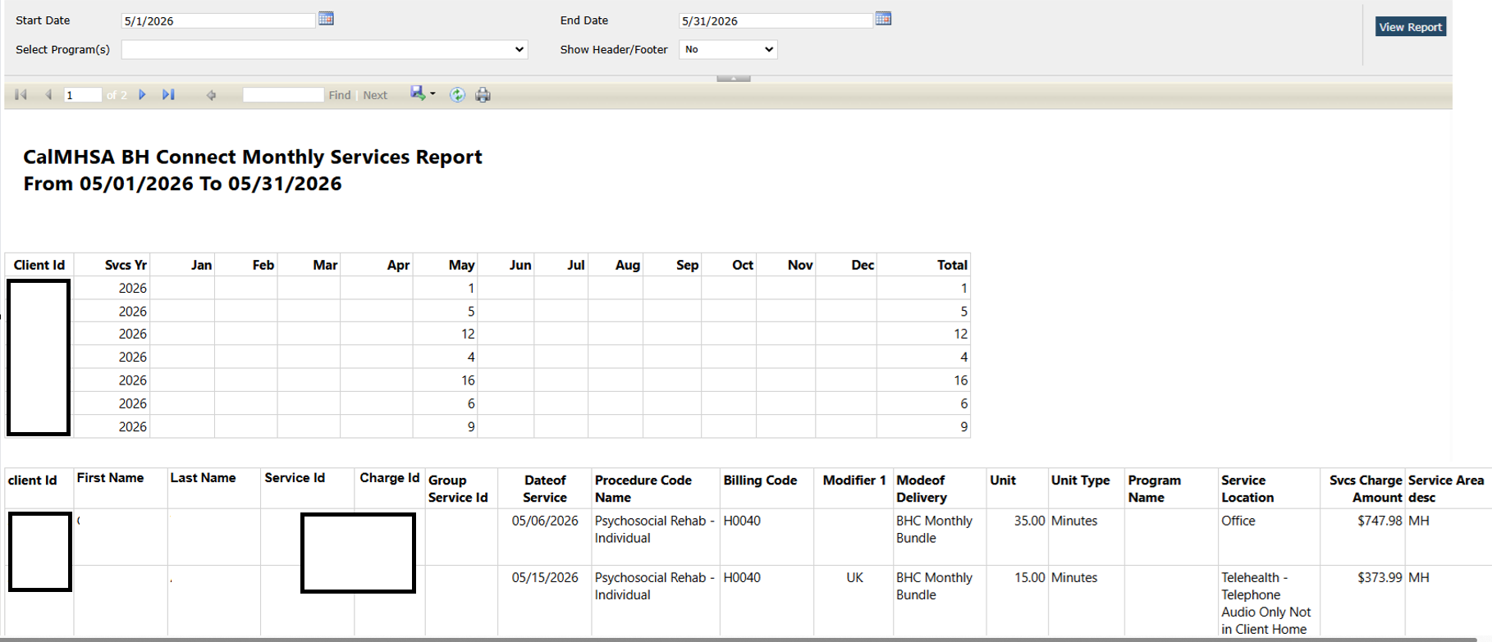
CalMHSA 120 – BH Connect Monthly Services Report
Notes:
You should still document your Client’s consent preferences, even if they decline the disclosure of any data authorized by the Form by selecting the “No” checkbox. This avoids re-requesting your Client’s consent to share their data and records their request to not share that data.
Signing the Form is optional, and your Client may decline to complete the Form.

Slide 13
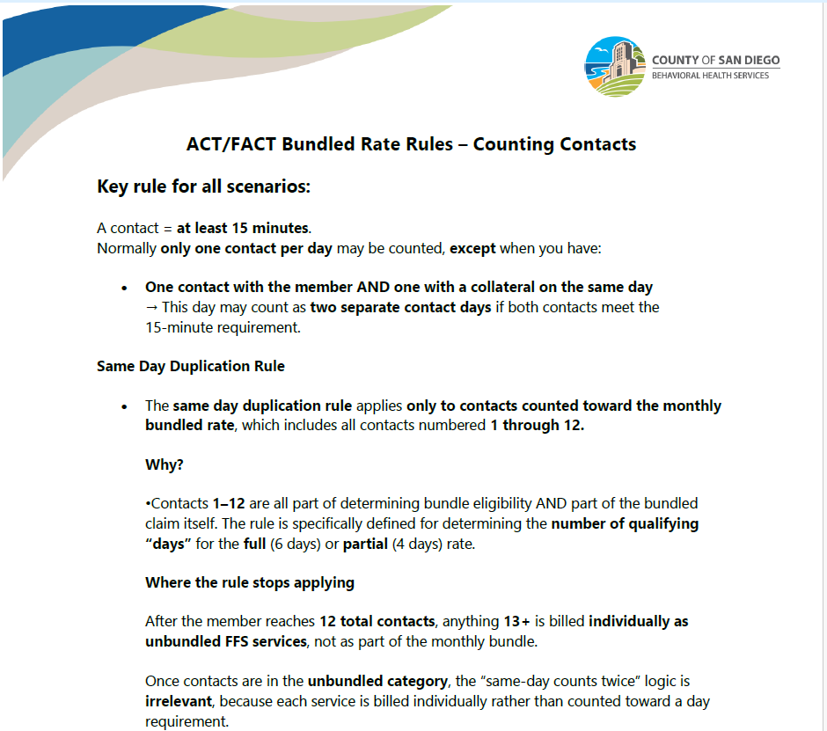
ACT/FACT Bundled Rate Rules – Counting Contacts

Slide 14

Report Training and Resources
Current Efforts
  Optum SmartCare Training
  SmartCare Help Desk Support
  SmartCare ARF: Treatment Programs
  Centralized E-mail support:
  BHS-DataScience.HHSA@sdcounty.ca.gov

Slide 15
Who to Contact?
Who to Contact | How to Contact
SmartCare System issues: i.e. glitches, functionality issues, pop-up errors | CalMHSA various options: 1. Connect via Live Chat (M-F 8:00am – 5:00pm) a. 2023.calmhsa.org b. Access when logged in to the SmartCare EHR 2. Submit a ticket (M-F 8:00am – 5:00pm) a. 2023.calmhsa.org b. Access when logged in to the SmartCare HER 3. After Hours support (only available for system outages) a. Call (916) 214-8348
Password Resets and Account Unlock | Call 1-800-834-3792 (Available daily from 4:30am – 11:00pm including weekends and holidays)
SmartCare ARF submission and any access related issues or questions | BHS_EHRAccessRequest.HHSA@sdcounty.ca.gov
SmartCare support questions that cannot be addressed by the CalMHSA Support Desk should be directed to MIS | BHS_EHRSupport.HHSA@sdcounty.ca.gov
For questions related to documentation guidelines, DHCS regulations or policy | QIMatters.HHSA@sdcounty.ca.gov
Billing Issues or Questions that cannot be addressed by the CalMHSA Help Desk | Mental Health: MHBillingUnit.BHS@sdcounty.ca.gov MH Billing Line: 619-338-2612 SUD: SUDBillingUnit.BHS@sdcounty.ca.gov SUD Billing Line: 619-338-2584
Reports and Data Questions | BHS-DataScience.HHSA@sdcounty.ca.gov

